Slide 1

HEART DISEASE ANALYSIS
USING MACHINE LEARNING

Slide 2

AGENDA
INTRODUCTION
PROBLEM STATEMENT
ABSTRACT
LIBRARIES USED
RESULTS
CONCLUSION

Slide 3
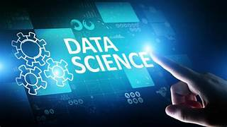
INTRODUCTION
In order to find patterns and insights that support decision-making, data must be studied and interpreted.This is where data analysis and visualization come into play.
Complex information is simpler to comprehend and
convey when data is given pictorial through visualization.

Slide 4

PROBLEM STATEMENT
Heart disease ranks among the top causes of global mortality.
Early detection plays a vital role in preventing and treating heart disease.
This project focuses on analyzing heart disease data to uncover patterns and risk factors.
The goal is to develop a predictive model for classifying individuals' heart disease status.
The model will utilize clinical and demographic factors for accurate classification.

Slide 5

ABSTRACT
Heart disease is a global health threat requiring timely diagnostics.
Python is used for detailed analysis, focusing on exploration, feature engineering, and modeling.
A diverse dataset of clinical and demographic data guides the project.
The aim is to develop a predictive tool to differentiate heart disease presence.
Python libraries like Pandas, NumPy, Matplotlib, Seaborn, and Scikit-learn drive data manipulation and modeling.
Insights gleaned highlight critical factors, paving the way for enhanced cardiovascular care.

Slide 6
LIBRARIES
Pandas: For data manipulation and preprocessing.
NumPy: For numerical computations and array operations.
Matplotlib and Seaborn: For data visualization.
Scikit-learn: For machine learning model development and evaluation.
Google Colab: For interactive development and documentation.

Slide 7
RESULTS
Data analysis and visualization efforts yielded valuable insights into heart disease patterns and risk factors.
Comprehensive exploratory data analysis (EDA) revealed notable trends and relationships within the dataset.
Visualizations like histograms, box plots, and correlation matrices deepened our understanding of variable distributions and interactions.
Visualization techniques helped identify outliers and missing data, guiding preprocessing efforts.
Visual insights informed subsequent machine learning model development.
Enhanced model accuracy for heart disease detection and risk assessment resulted from these efforts.

Slide 8
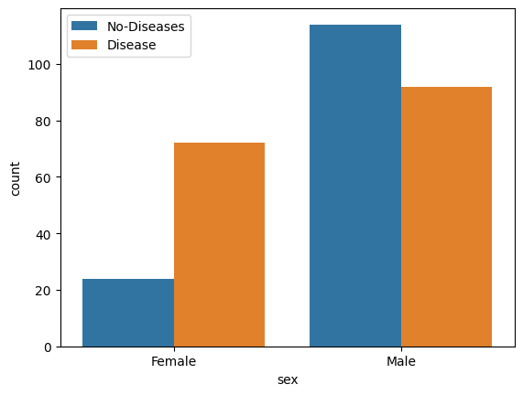

Slide 9
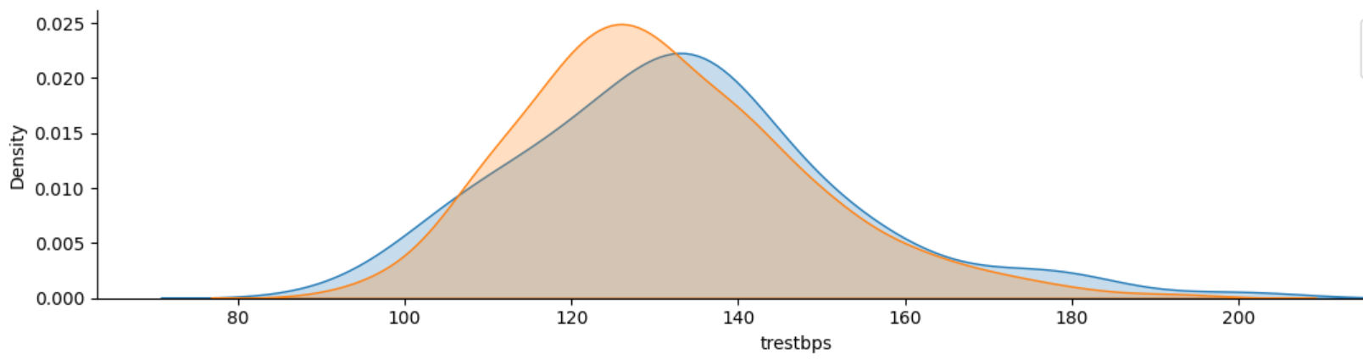

Slide 10
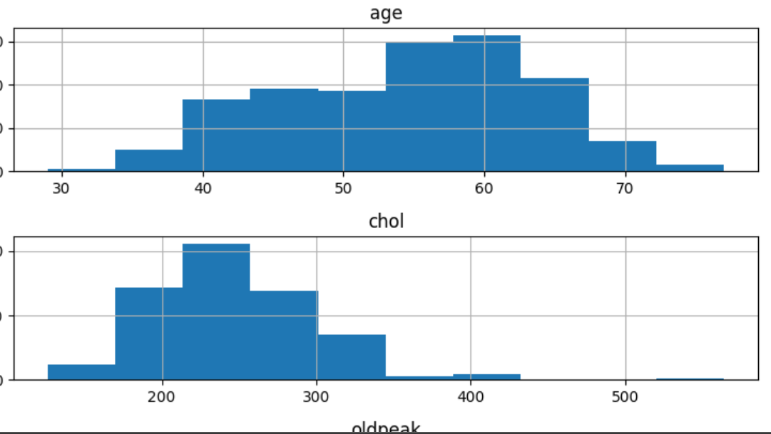

Slide 11
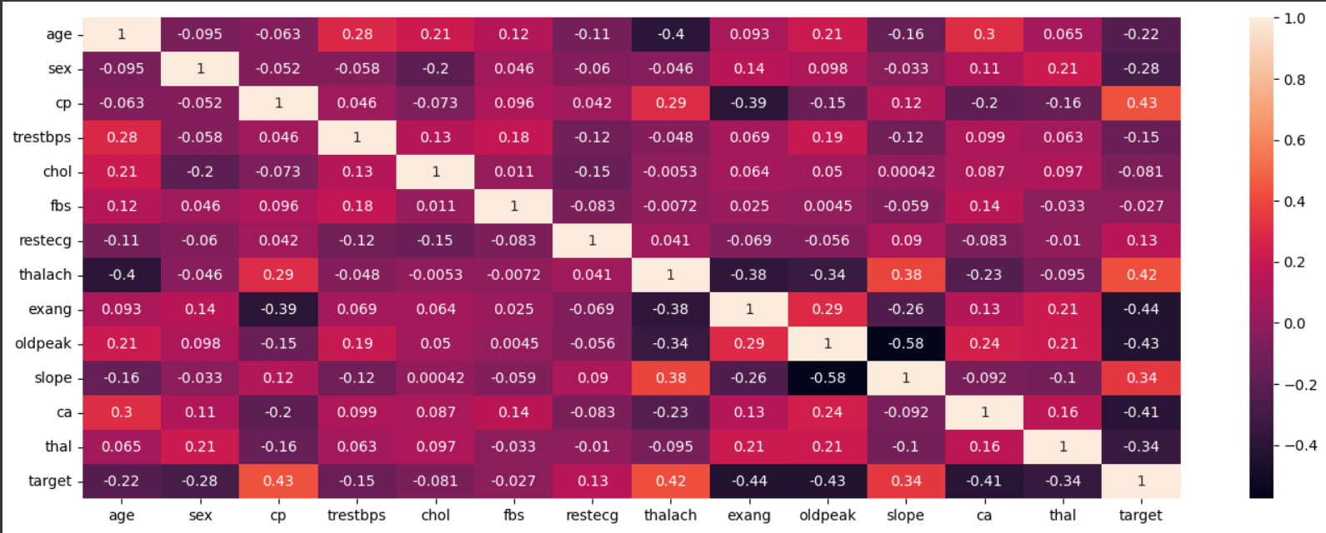

Slide 12
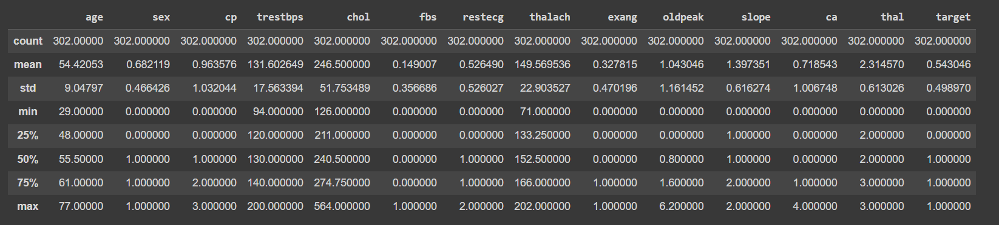

Slide 13

CONCLUSION
Analyzing heart disease data using Python enhanced cardiovascular healthcare.
Rigorous data exploration and visualization revealed crucial patterns and relationships.
Key risk factors and biomarkers for heart disease were identified, aiding early intervention.
Python libraries like Pandas, NumPy, Matplotlib, and Seaborn facilitated efficient data handling and visualization.
Significant correlations between demographic factors, clinical indicators, and heart disease prevalence were discovered.

